Slide 1
The Little Green Web App
A website by:
Jonas M. Olsson, John Harrow and Jack Wier

Slide 2
The Applications of the Website
Information about eco-friendly living, map, recipes and a quiz for fun
Mixes fun, information and a map
Targeted at young people
People that moved recently

Slide 3
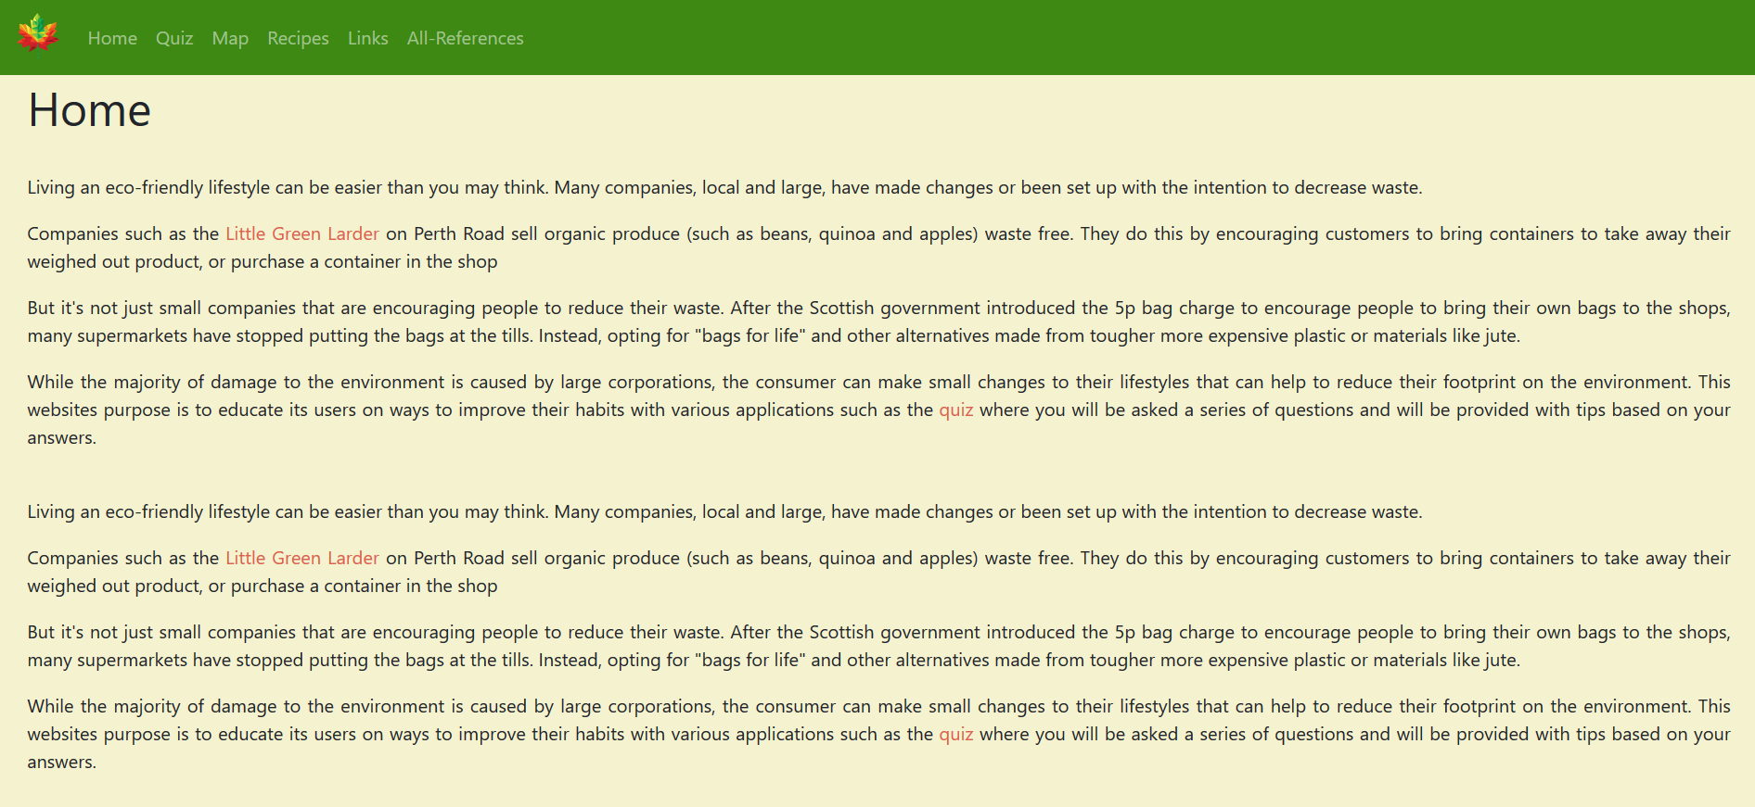
The Home-page

Slide 4
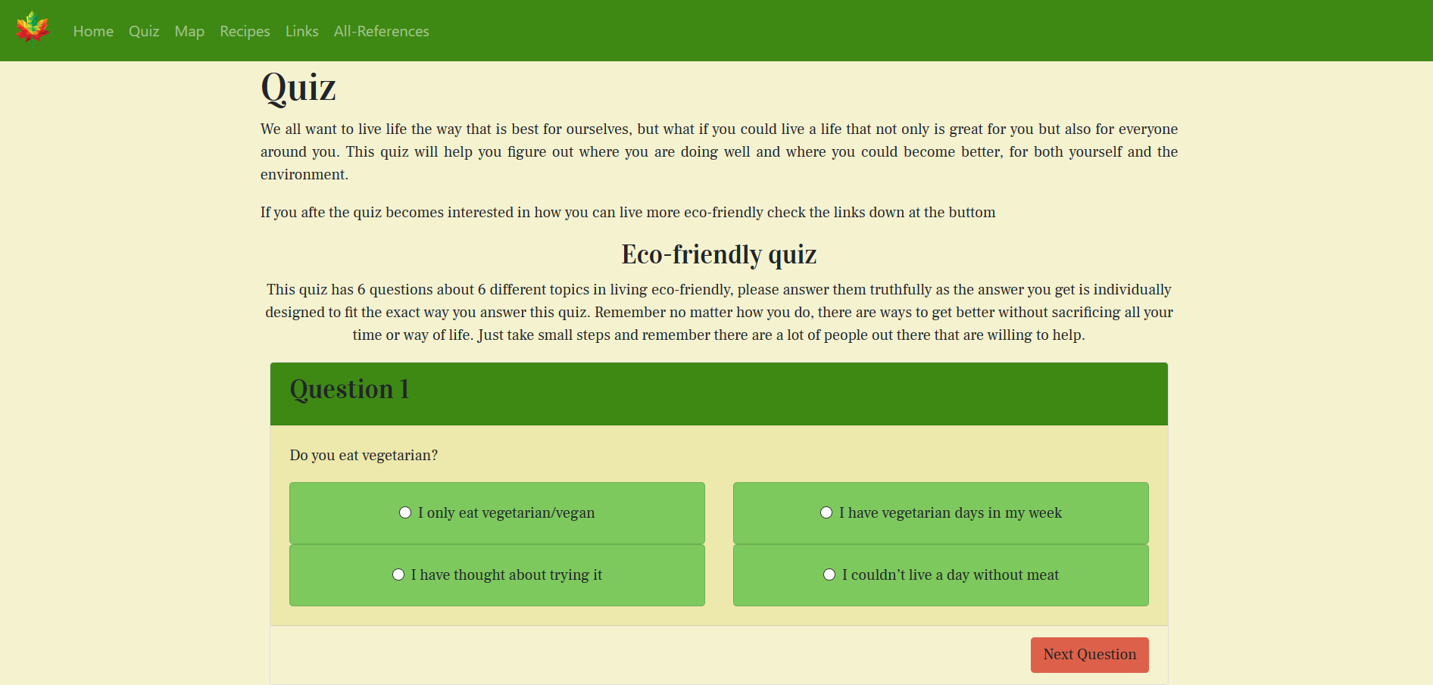
The quiz
The quiz ask 6 questions, from 6 different topics in eco-friendly living
The quiz gives an individual response depending on what you answer in each question
Links to other advice pages

Slide 5
Map

Slide 6
Recipes

Slide 7
Now a live presentation
“#Insert link”

Slide 8
Why our application is needed
Mixes fun and information
Nice down on earth website to give advice without judgement

Slide 9
That was All for this time, Bye
Made by Jonas M. Olsson, John Harrow and Jack Weir

